Slide 1
Invaders from Space
ECE 540 Winter 2019
Brian Henson, Bradon Kanyid, Grant Vesely, Jamie Williams

Slide 2
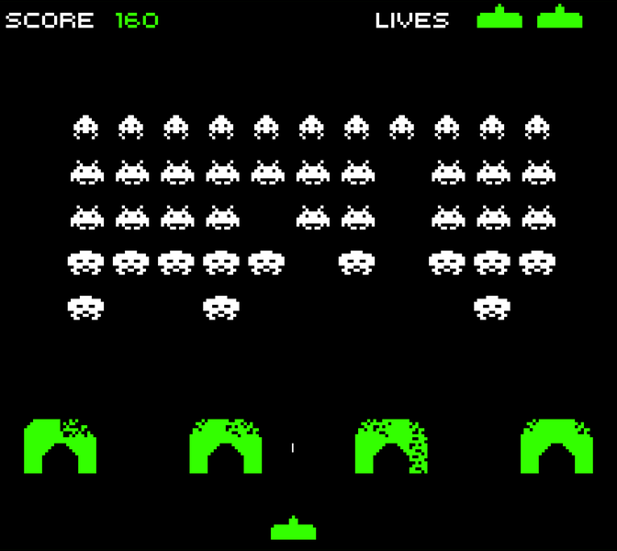
The Goal: this, but better!

Slide 3
List of Features
Base
Stretch
Space Invaders style game running on the Nexys A7 board
Controlled using Atari Paddle Controller(s)
VGA display at 1024x768
Score calculation and display (7seg or VGA)
Start menu with game options
Multiplayer gameplay (with 2nd controller)
Sound effects via Nexys audio output
Upgraded graphics and animations
Additional game modes/enemies/power-ups

Slide 4
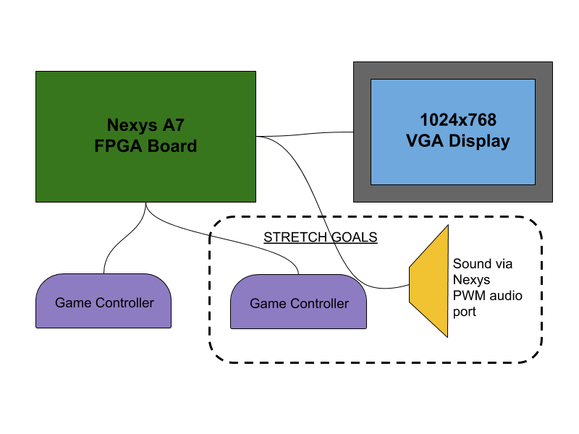
Block Diagram of Hardware

Slide 5
Audio module & spritework: Jamie Williams
Audio
Sprites
Nexys A7 board: Simple 1-bit audio out + enable
Sound driven by PWM output, predictably having issues with sound quality
Eventually will have frequency-stored sound “files”, playback triggered by AHB
Will have effects for major events (Ex shooting, dying, barrier being hit)
Will use 16x16 icons, will improve on original graphics with more colors to work with
Icons will be animated (Ex movement, death, shooting)
Detail in icons and animation dependent on VGA implementation

Slide 6
Controller Input and Video: Bradon Kanyid
Using Atari Paddle controllers (analog turn + 1 button)
Special PMOD port for A2D. Working XADC example! Easier than expected
IP module included with Vivado
Continually converting 2 analog inputs to 2x 12-bit results, filtering, and exposing via AHB
Plan to make a simple PCB (probably) that holds the interface to the paddles

Slide 7
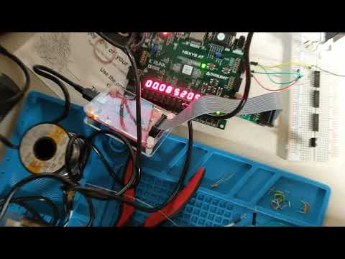
Demo Video of XADC and Paddles

Slide 8
Video: VGA Sprite Controller
1024x768 resolution, same as project 2
Fully generic sprite-based display! (ambitious!)
Sprite table, each entry holds addr (which sprite to display) + Xpos + Ypos + enable
Determine which sprites to show on a horizontal line by precomputing during VBLANK
Sprite table filled from software instead of block ROM via dedicated Sprite RAM section exposed to AHB.

Slide 9
Module integration: Brian Henson
Uninteresting boilerplate project prep like ripping out the Rojobot stuff
Several hours preparing “placeholders” for the XADC, VGA, and audio modules
Modified mfp_sys.v to allow AHB modules outside the design (top-level)
Life hack: set m14k_top.v as an out-of-context run: save 6 minutes of synthesis!!!

Slide 10
Software: Grant Vesely & Brian Henson
Going to make it all in C (thanks to Bradon and the MIPSfpga+ project!)
Planned architecture: RTOS-like scheduler
Periodic & non-periodic events
Single main loop runs continuously, and conditionally runs different sub-systems (input, graphics, collisions) by comparing against central clock
Run code to move bullets at 200 Hz, get player input & move at 100 Hz, etc.

Slide 11
Milestone Progress
Week of Feb 24th:
Project divided parts and assigned to people
Week of Mar 3rd:
Get hardware controller working with Nexys board
Outline basic game logic/create a full algorithm, start coding
Create basic graphics elements and get base VGA output working
Plan for stretch goals, work on audio
Week of Mar 10th:
Finish base game logic, work on score calculation
Finish basic form of game, make playable (controller, graphics, game logic integration)
Start integrating code from stretch goals into the base game
Week of Mar 17th:
Add and debug/test any added features/stretch goals
Write up final reports and documents
Create presentation for final demo and practice

